Slide 1
Local & Global Variables
ELEC1006: ENGINEERING COMPUTING

Slide 2

Local Variables
Variables defined inside a function are local to that function. They are hidden from the statements in other functions, which normally cannot access them.
Because the variables defined in a function are hidden, other functions may have separate, distinct variables with the same name.
PAGE 2

Slide 3
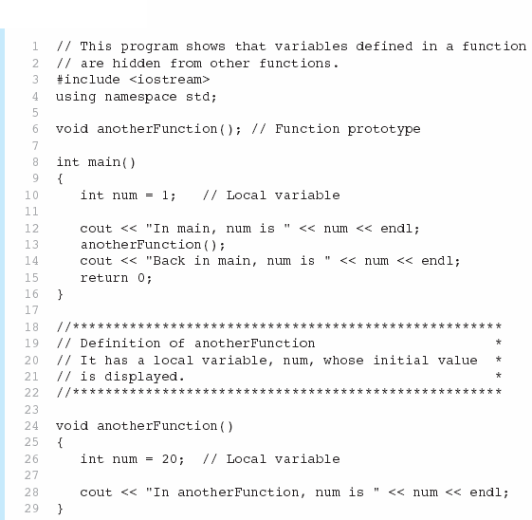

Example 1
PAGE 3

Slide 4
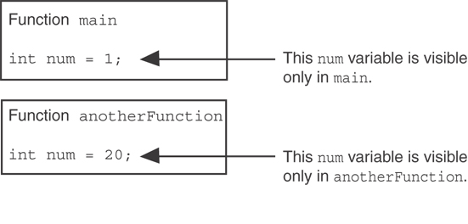
Example 1 continued …
When the program is executing in main, the num variable defined in main is visible only in main.
The num variable in anotherFunction is visible only in anotherFunction and is separate from the num used in main.
PAGE 4

Slide 5
Lifetime of a Local Variable
A function’s local variables exist only while the function is executing. This is known as the lifetime of a local variable.
When the function begins, its local variables and its parameter variables are created in memory, and when the function ends, the local variables and parameter variables are destroyed.
This means that any value stored in a local variable in a called function is lost when the called function ends and execution returns to the calling function.
PAGE 5

Slide 6
Global Variables & Global Constants
A global variable is any variable defined outside all the functions in a program.
The scope of a global variable is the portion of the program from the global variable definition to the end of the source code.
This means that a global variable can be accessed by all functions that are defined after the global variable is defined.
PAGE 6

Slide 7
Warning on using Global Variables
You should avoid using global variables because they make programs difficult to debug.
Any global that you create should be global constants.
PAGE 7

Slide 8
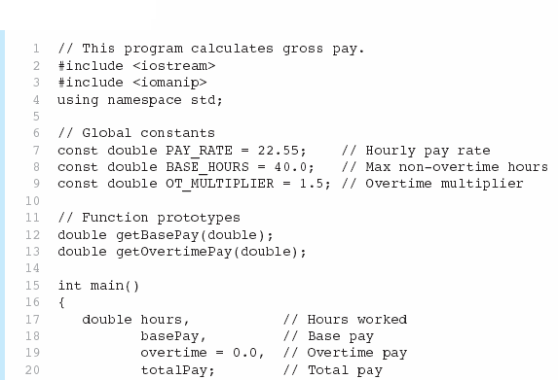
Example 2
Global constants defined for values that do not change throughout the program’s execution.
PAGE 8

Slide 9



Example 2 continued …
The constants are then used for those values throughout the program.
PAGE 9

Slide 10
Initialising Local & Global Variables
Local variables are not automatically initialized. They must be initialized by programmer.
Global variables (not constants) are automatically initialized to 0 (numeric) or NULL (character) when the variable is defined.
PAGE 10

Slide 11
More info
[1] cplusplus.com: Variables. Data Types.
https://www.cplusplus.com/doc/oldtutorial/variables/
[2] learncpp.com: 6.3 – Local variables
https://www.learncpp.com/cpp-tutorial/local-variables/
[3] learncpp.com: 6.4 – Introduction to global variables
https://www.learncpp.com/cpp-tutorial/introduction-to- global-variables/
PAGE 11

